Slide 1
Results Antonym generation

Slide 2
Generate Antonyms from scratch
Approach:
User selects a category (e.g. Countries)
Search Wikipedia for entries from this category (e.g. Germany)
Retrieve Wikipedia articles
Look up antonyms for each word used in the article
Add word- antonym pair to set of pairs
Select Top n (e.g. 300) pairs with “Orthogonality maximization” (from POLAR)
Transfer model into Polar space (from POLAR)

Slide 3
Example Countries
Used Wikipedia pages of Countries with biggest GDP
United States ,China, Japan, Germany, United Kingdom, France, India, Italy, Canada, Russia
Generated Antonym pairs: 1677 (adding more countries didn’t increase this Number too much)
Applied Polar with 300 Dimensions
First observation: Most generated antonyms are very general and non-expressive for the category, e.g.
('known', 'unknown'), ('equal', 'differ'), ('central', 'peripheral'),('major', 'minor'), ('square', 'round'), ('straight', 'crooked'), ('most', 'fewest'), ('most', 'least'), ('uppercase', 'lowercase'), ('new', 'old'), ('new', 'worn'), ('least', 'most’) ('notice', 'ignore'), ('marked', 'unmarked'), ('worsen', 'better'), ('refuse', 'accept'),
However, some interesting ones:
('north', 'south’), ('urban', 'rural'), ('military', 'civilian'), ('nuclear', 'conventional'), ('nuclear', 'conventional'), ('civil', 'uncivil'), ('war', 'peace'), ('export', 'import')

Slide 4
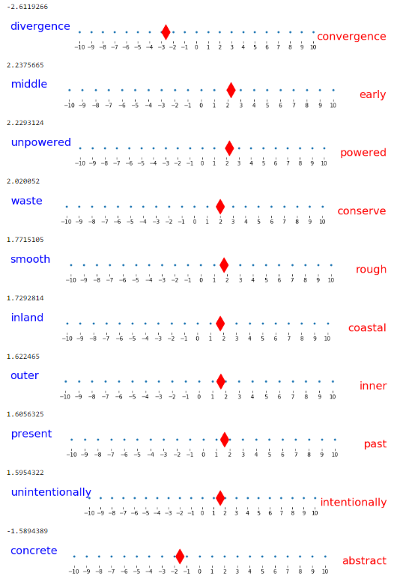
USA

Slide 5
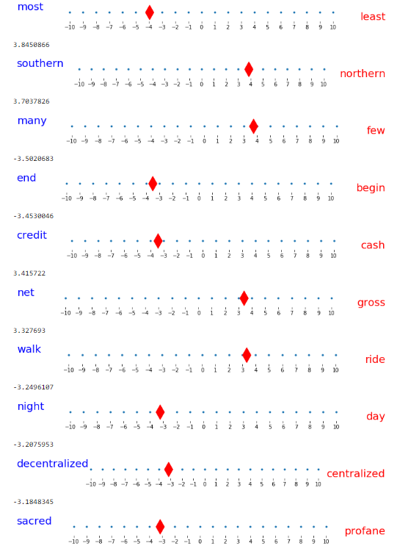
China

Slide 6
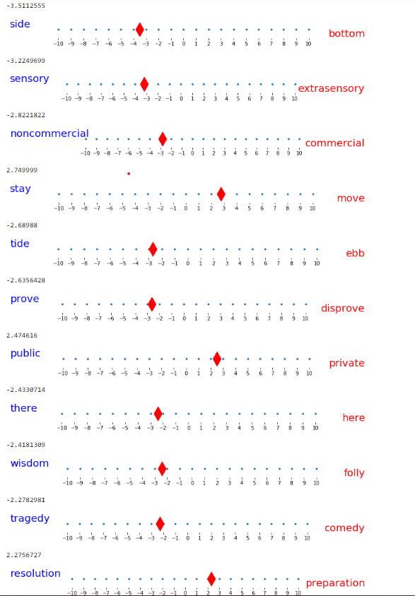
Can you guess? Probably not

Slide 7
Same for music genres
We marked in red the pairs we think are interesting:
('popular', 'unpopular'), ('like', 'dislike'), ('like', 'unlike'), ('traditional', 'nontraditional'), ('equal', 'differ'), ('most', 'fewest'), ('most', 'least'), ('on', 'off’), ('western', 'eastern'), ('many', 'few'), ('deviate', 'conform'), ('take', 'give'), ('accept', 'refuse'), ('necessitate', 'obviate'), ('consume', 'abstain'), ('claim', 'disclaim’), ('sound', 'silence'), ('have', 'lack'), ('new', 'old'), ('new', 'worn'), ('adopted', 'native'), ('record', 'erase'), ('studio', 'location'), ('particular', 'general'), ('specific', 'general’), ('specific', 'nonspecific'), ('used', 'misused'), ('general', 'particular'), ('general', 'specific'), ('general', 'local'), ('more', 'less'), ('more', 'fewer'), ('familiar', 'unfamiliar'), ('familiar', 'strange’), ('win', 'lose'), ('gain', 'reduce'), ('popularity', 'unpopularity'), ('powerful', 'powerless'), ('appearance', 'disappearance'), ('late', 'early'), ('begin', 'end'), ('start', 'stop'), ('cover', 'uncover’)

Slide 8
First Conclusion: We need some “Guidance”
“Hard code“ 50 Category specific Pairs
Example Country: Observation: Many don’t have “real” antonyms
Geographic
east west
north south
europa asia
america eurasien
africa australia
scandinavian baltic
america russia
america china
russia china
atlantic pacific
Language:
latino hispanic
english russian
english chinese
english spanish
spanish portuguese
Landscape:
ocean land
large small
arctic southern
island neighbor
flat mountain
coast border
metropolitan rural
cityside countryside
big tiny
long wide
Colors:
black white
brown white
yellow white
grey green
grey blue
Politics& People:
civilized uncivilized
modern traditional
catholic muslim
catholic buddhism
hindi muslim
democratic monarchic
potato rice
calm busy
cosmopolitan provincial
touristy limited
Weather:
dry humid
hot cold
tropical mediterranean
desert vegetation
Money making:
export import
banking agriculture
port airport
developed undeveloped
first third
poor rich
farming development

Slide 9
4. Approach
Start with hardcoded 50 antonyms
Instead of using synonyms, use similar words
Example: ("salty", "sweet")
Using word2vec.wv.most_similar()
[('salty', 'sweet'), ('tangy', 'sweet'), ('savoury', 'tasteless'), ('pungent', 'tasteless’) ('fruity', 'sane'), ('fruity', 'tasteless'), ('sour', 'tasteless'), ('sour', 'fragrant'), ('sour', 'sweet'), ('sour', 'cloying'), ('sour', 'harmonious'), ('sour', 'syrupy'), ('sour', 'sweeten'), ('sour', 'honeyed'), ('sour', 'luscious'), ('sour', 'wholesome'), ('sour', 'untainted'), ('spicy', 'tasteless'), ('spicy', 'cold'), ('spicy', 'dull’)]
Pungent: having a sharply strong taste or smell.
tangy flavor: or smell is one that is sharp, especially a flavour like that of lemon juice
Using synonyms:
[('sweetness', 'unpleasantness')]

Slide 10
Still, generated antonyms are too general
('boggy', 'dry') ('downy', 'hard') ('conciliatory', 'cutting') ('bounded', 'immeasurable') ('dim', 'white') ('evaporated', 'liquid') ('purple', 'yellow') ('unexploded', 'unloaded') ('pleasing', 'ugly') ('broken', 'entire') ('loaded', 'unloaded') ('company', 'loneliness') ('comfortable', 'warm') ('loathsome', 'wholesome') ('entirety', 'grain') ('green', 'red') ('shell', 'soft') ('finite', 'immeasurable') ('brief', 'immeasurable') ('dried', 'wet') ('excellent', 'inferior') ('dappled', 'plain') ('lovely', 'ugly') ('freezing', 'hot') ('neutral', 'pink') ('tall', 'thick') ('processed', 'unprocessed') ('empty', 'rich') ('aggregate', 'grain') ('coarse', 'delicious') ('preserved', 'unprocessed') ('insoluble', 'liquid') ('metal', 'nonmetal')

Slide 11
Just in https://en.wikipedia.org/wiki/United_States the word Spanish appears 22 times. “english” just 21 times.

Slide 12
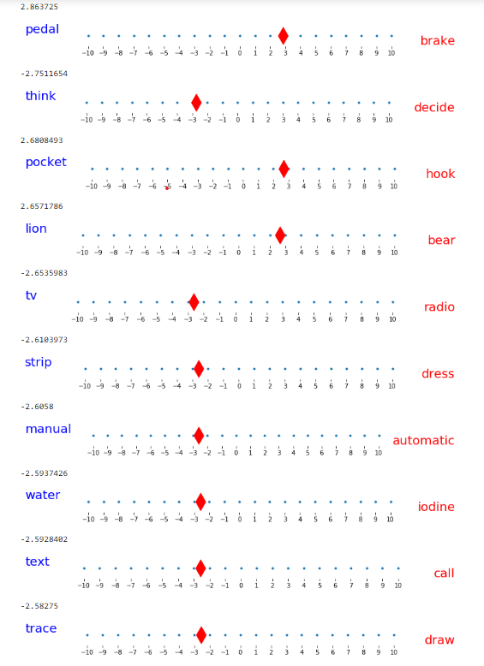
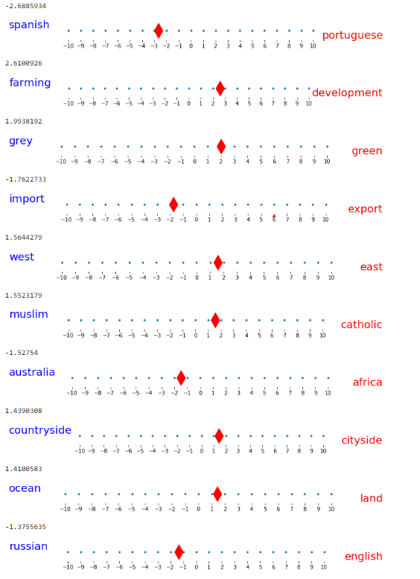
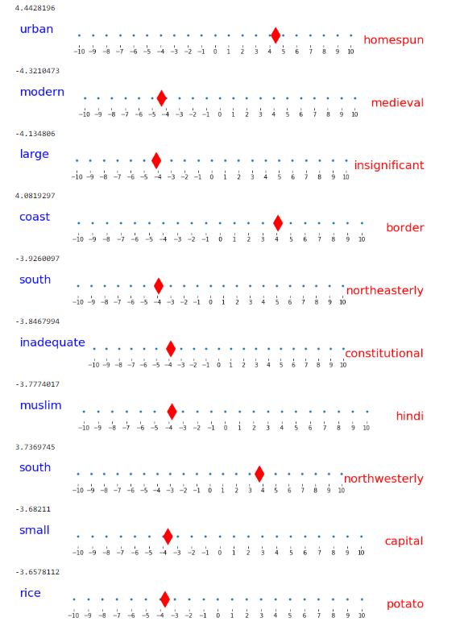
USA

Slide 13
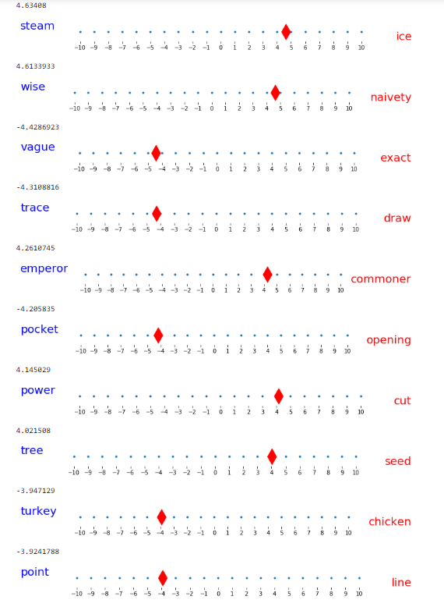
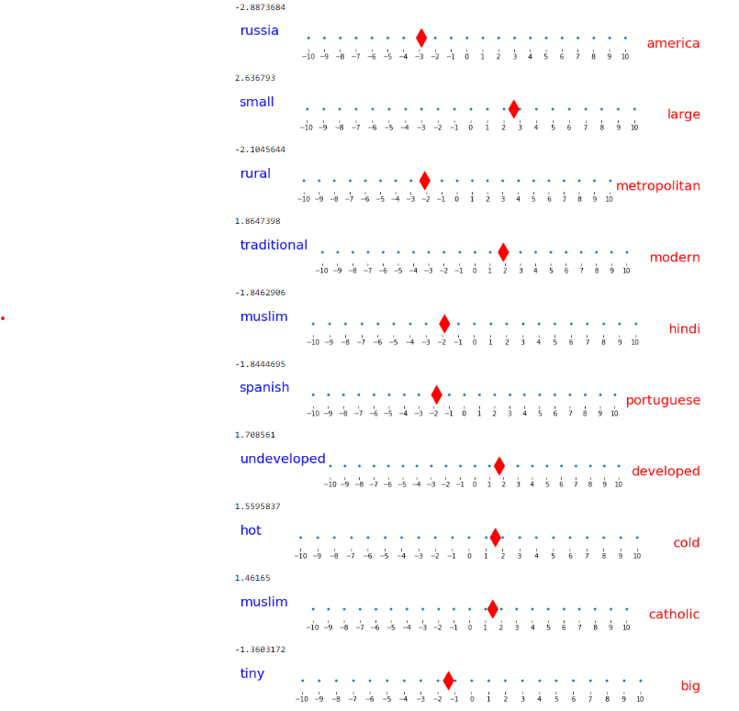
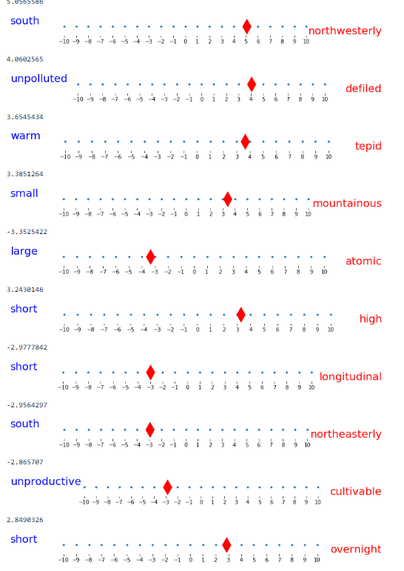
GERMANY

Slide 14
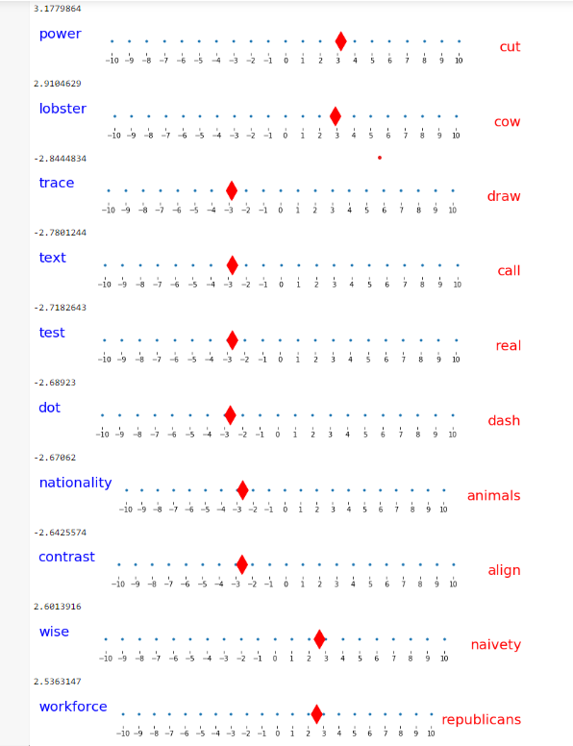
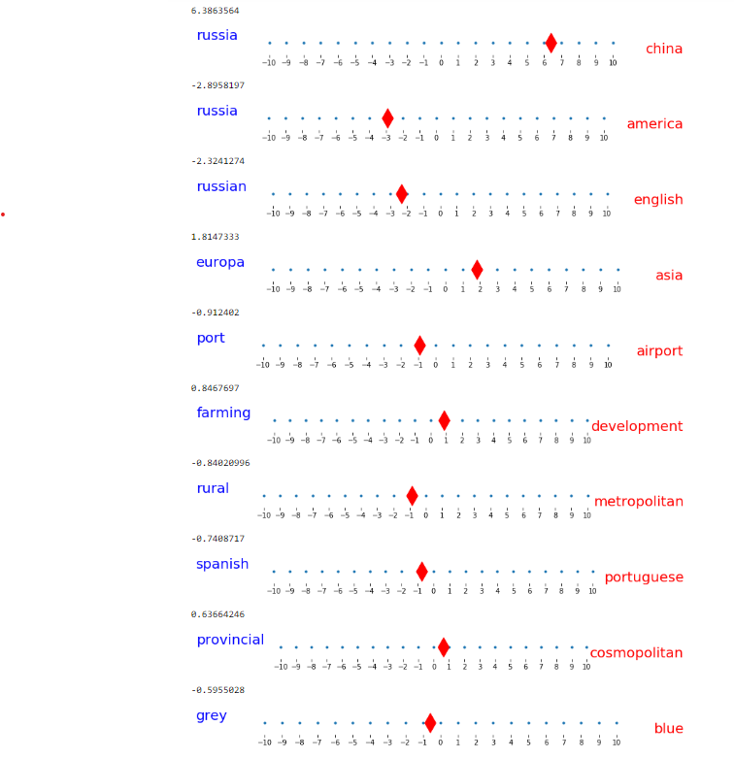
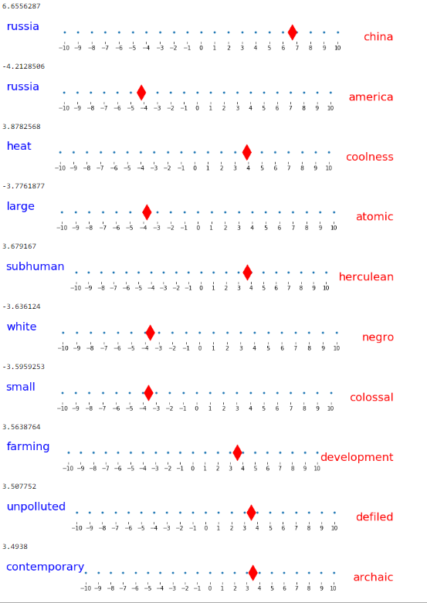
China

Slide 15
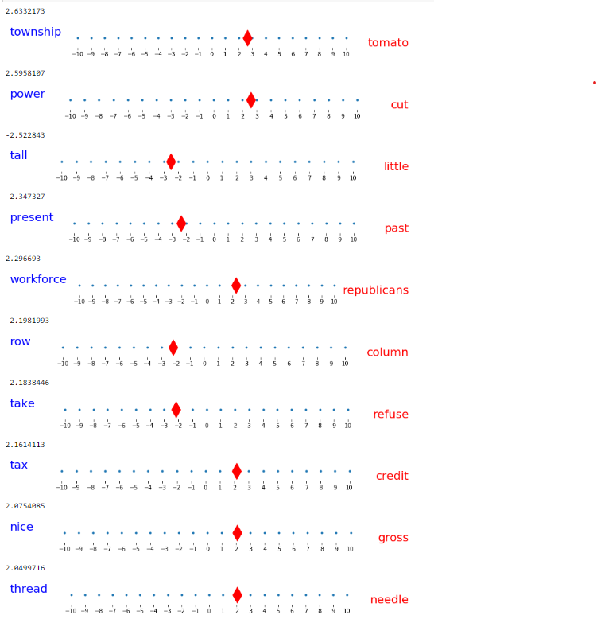
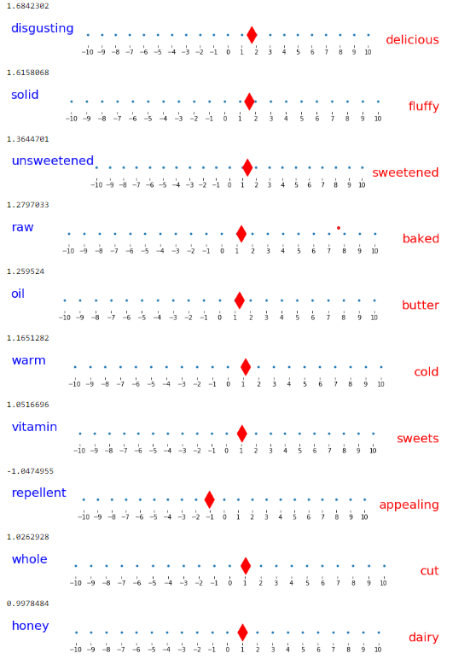
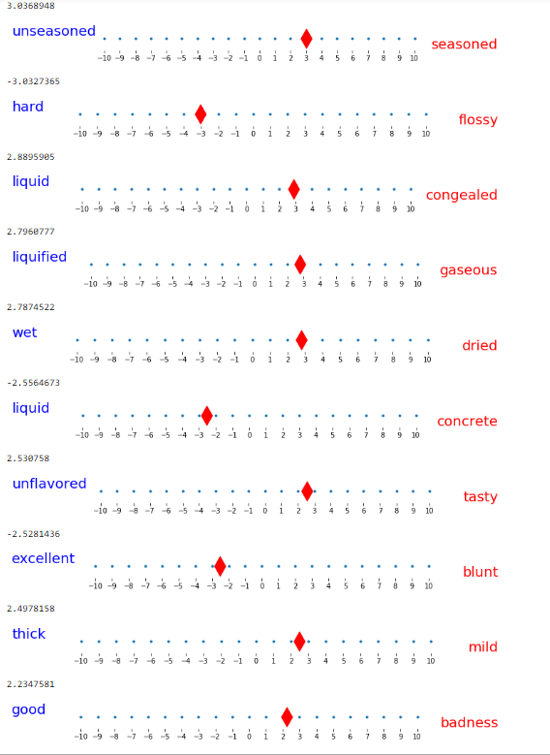
Steak

Slide 16
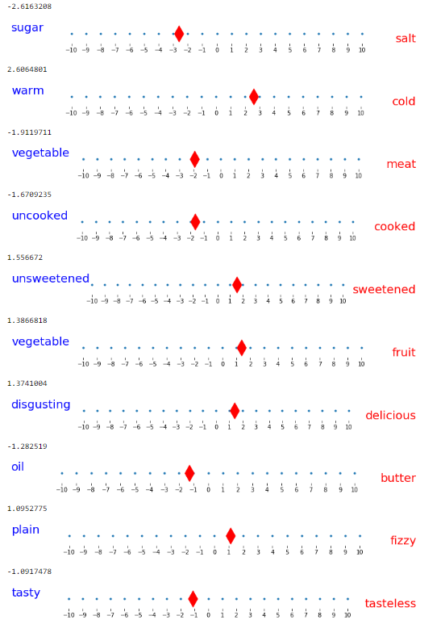
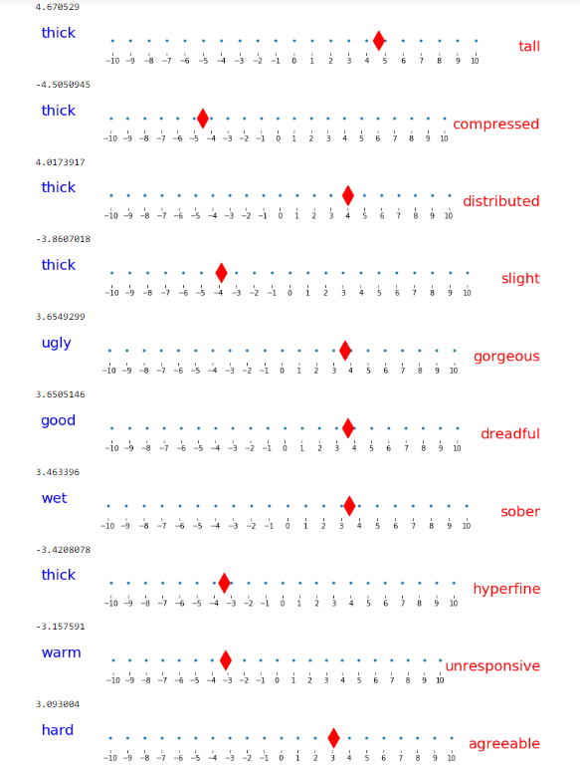
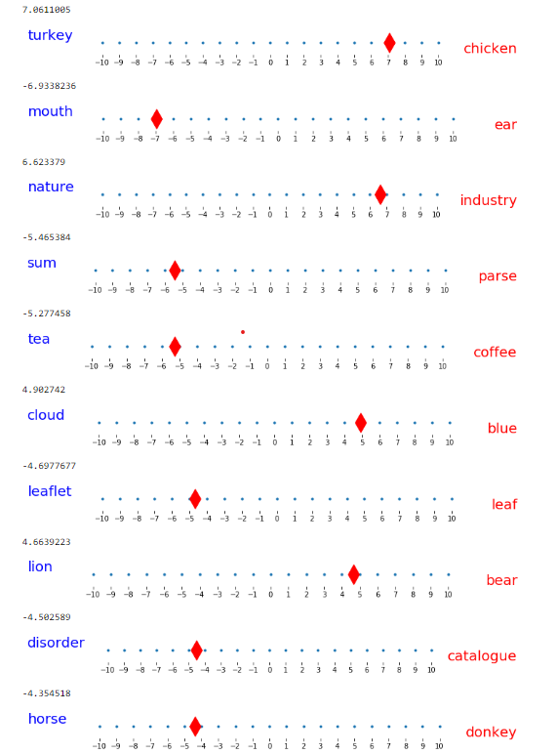
Banana

Slide 17
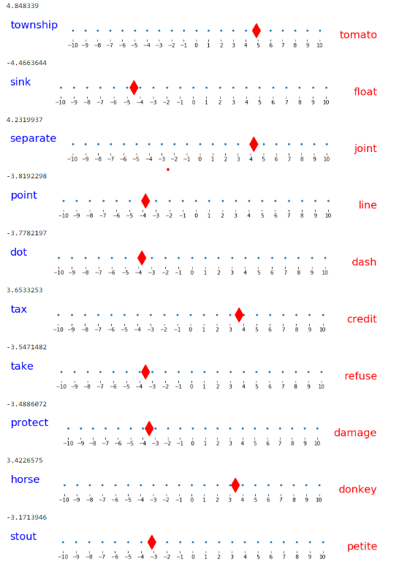
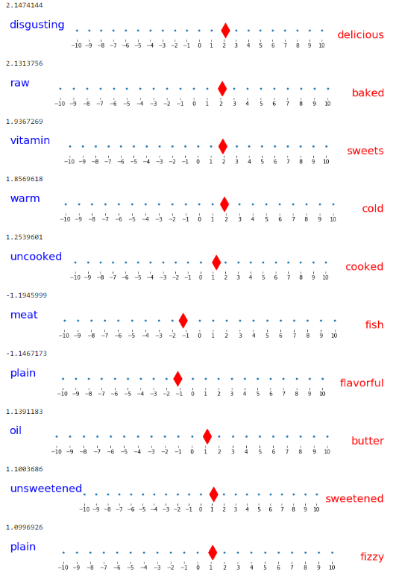
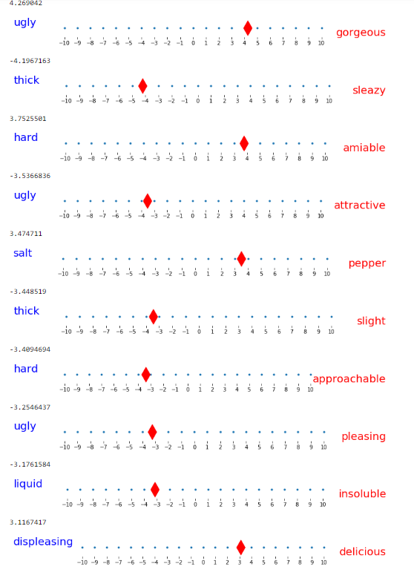
Cake

Slide 18
Conclusion
Automatically generating Antonym pairs lead to very general pairs which are not sufficient to describe the words from specific categories sufficiently

Slide 19
While in our explanations we only use antonyms, polar opposites could also include other terms, such as political terms representing politically opposite ideologies (e.g. republican vs. democrat) that could be obtained from political experts, or people representing opposite views (e.g. Chomsky vs. Norvig) that could be obtained from domain experts.

